Slide 1

u
x
v
Principal point : Cx, Cy
y

Slide 2
Z
Image plane
Y
X
World coordinate system
X_{c}
Z_{c}
Y_{c}
Camera coordinate system

Slide 3
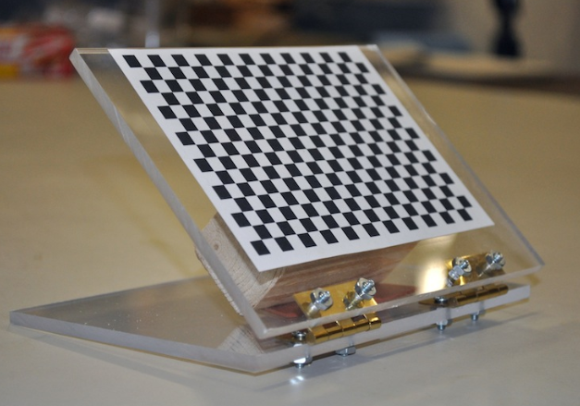
Y
Z
X
Image plane
X_{c}
World coordinate system, Z = 0 for all points
Z_{c}
Y_{c}
Camera coordinate system

Slide 4
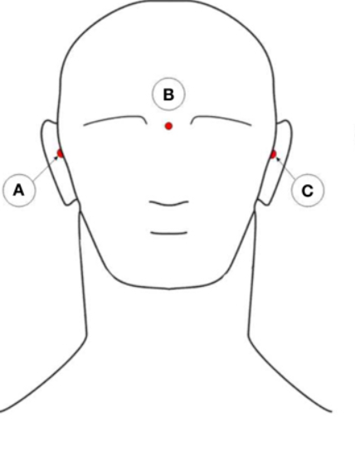
p
a
c
a : RPA, p : Nasion, c : LPA

Slide 5
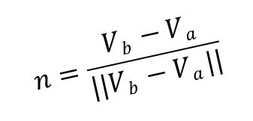
b
$$n=\frac{Vb −Va}{||Vb −Va ||}$$
b
a
p
a
p
V_{a} - V_{p}
V_{b}
V_{b}
V_{a}
V_{a}
V_{p}
V_{p}
X_{c}
X_{c}
Z_{c}
Z_{c}
Y_{c}
Y_{c}

Slide 6
z
((V_{a} – V_{p} ) . n ) n
b
y
t
a
x
p
V_{a} - V_{p}
p
V_{b}
V_{a}
o
V_{b}
V_{p}
V_{p}
X_{c}
Z_{c}
X_{c}
Z_{c}
Y_{c}
Y_{c}

Slide 7
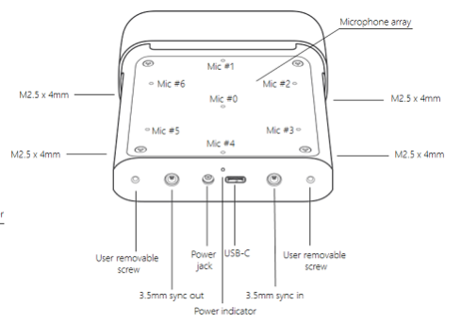
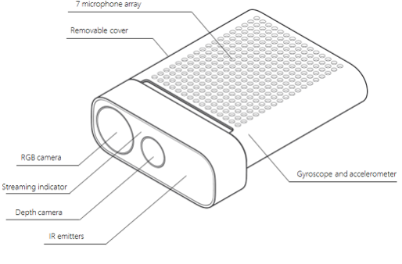

Slide 8


Slide 9
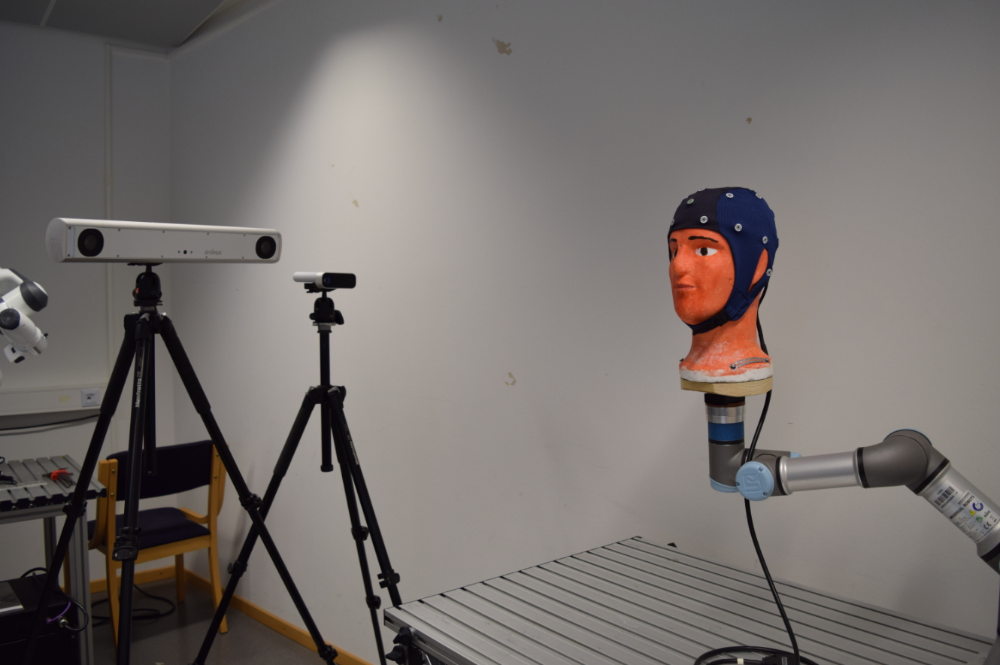
0
-56.5
0
Z
0
74.6
0
X
97.6
0
0
Y

Slide 10
Z
X
Y

Slide 11
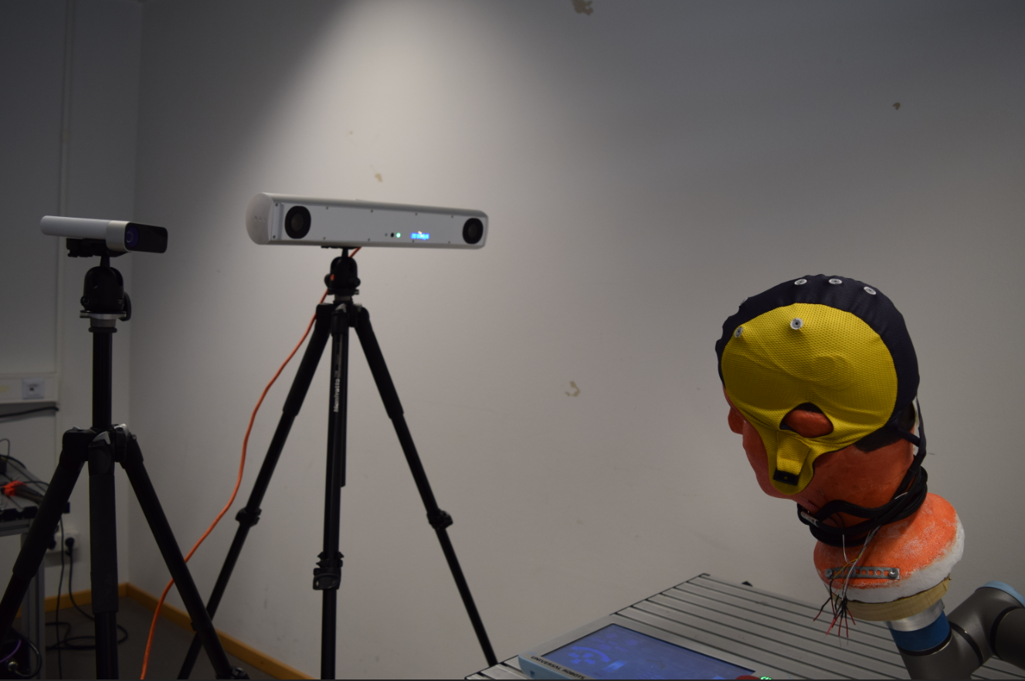

Slide 12
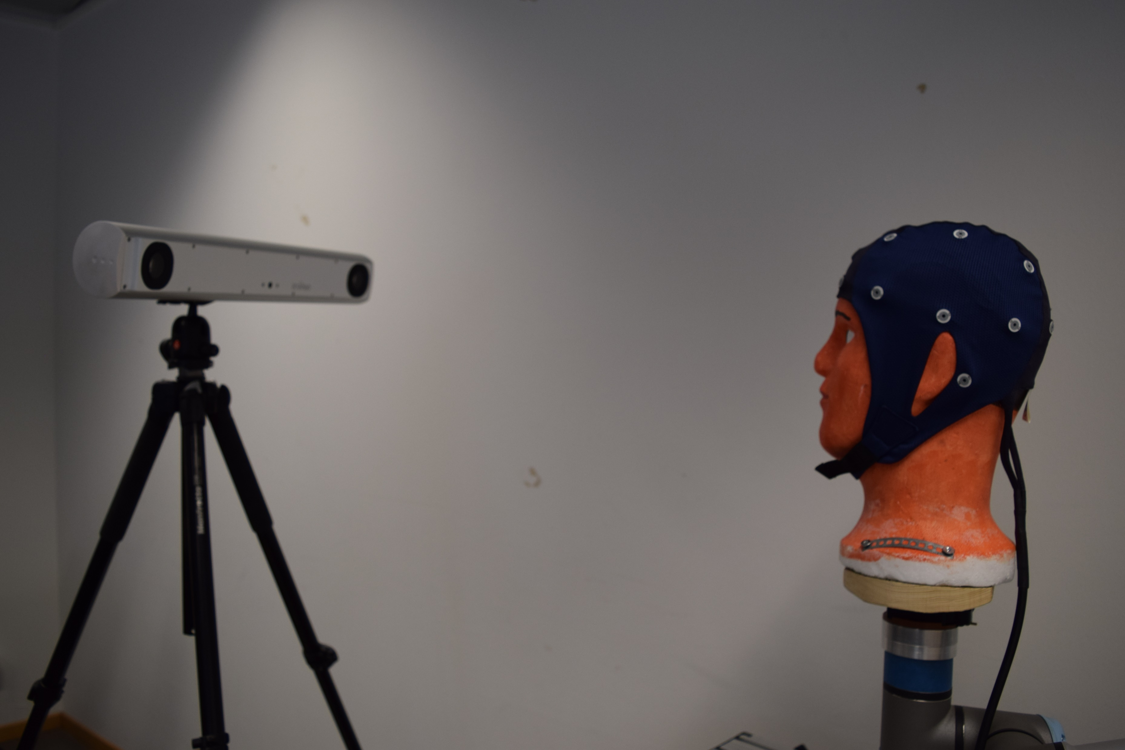

Slide 13

360 deg

Slide 14
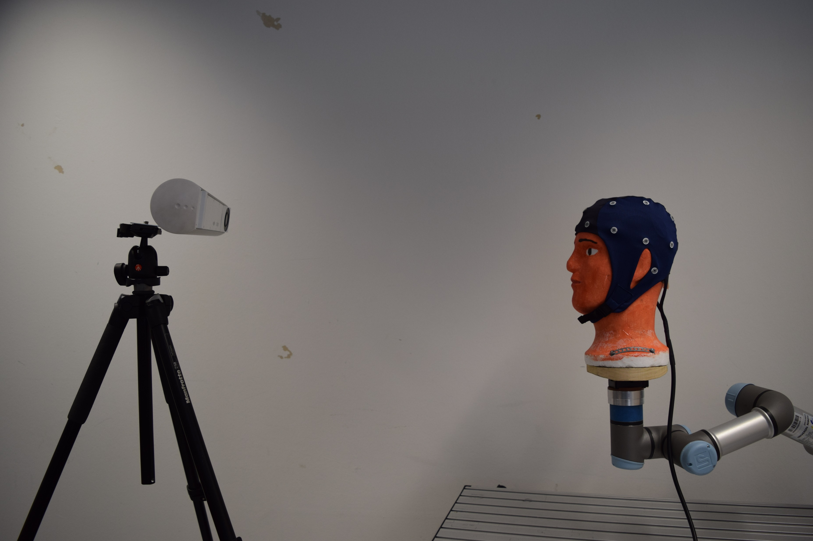

Slide 18
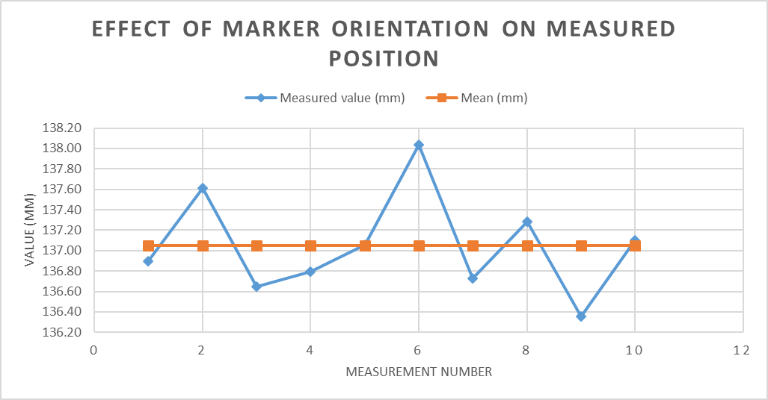

Slide 19
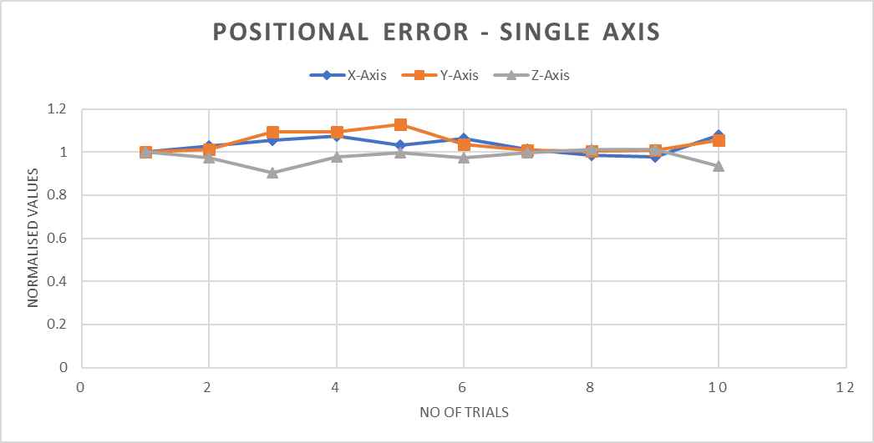

Slide 20
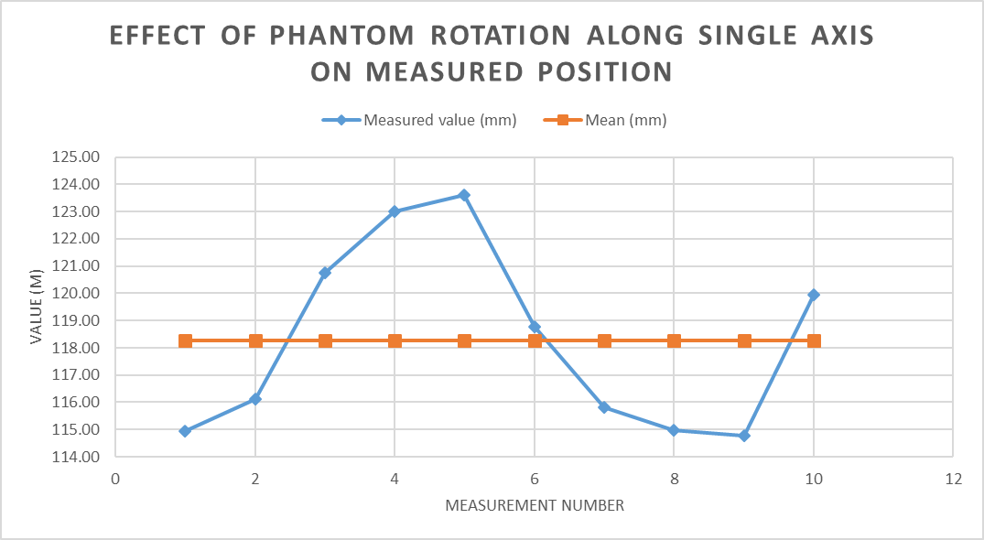

Slide 21
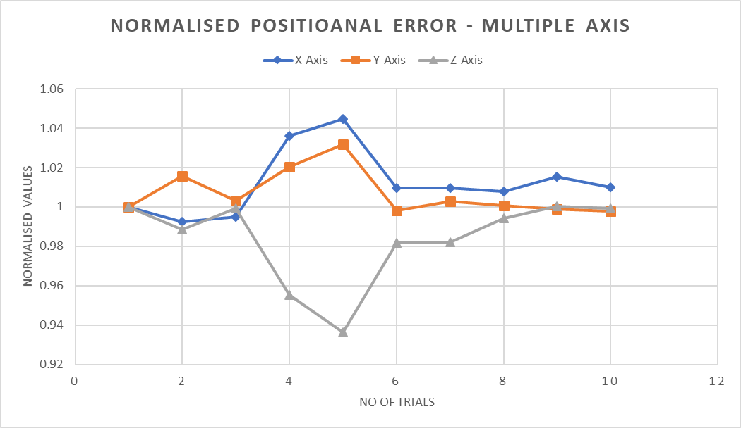

Slide 22
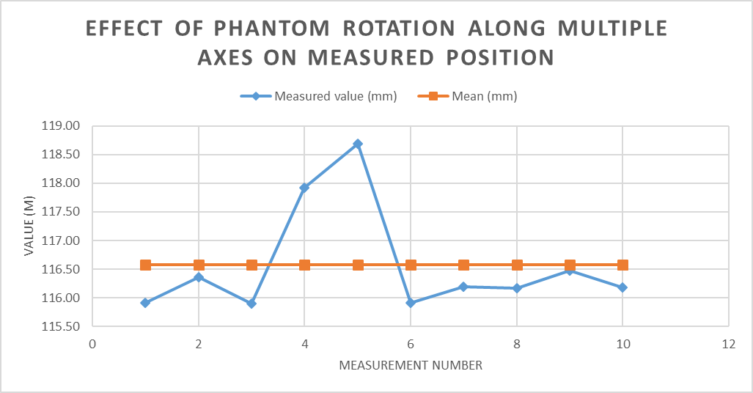

Slide 23
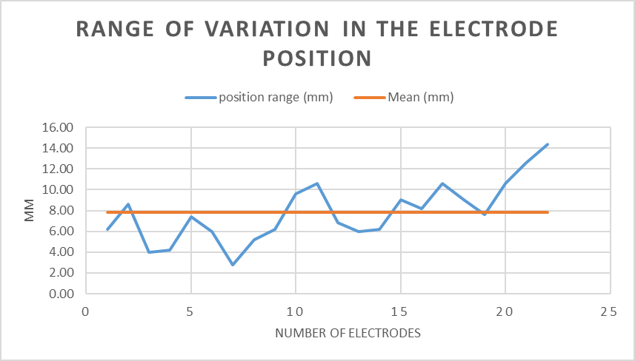

Slide 25
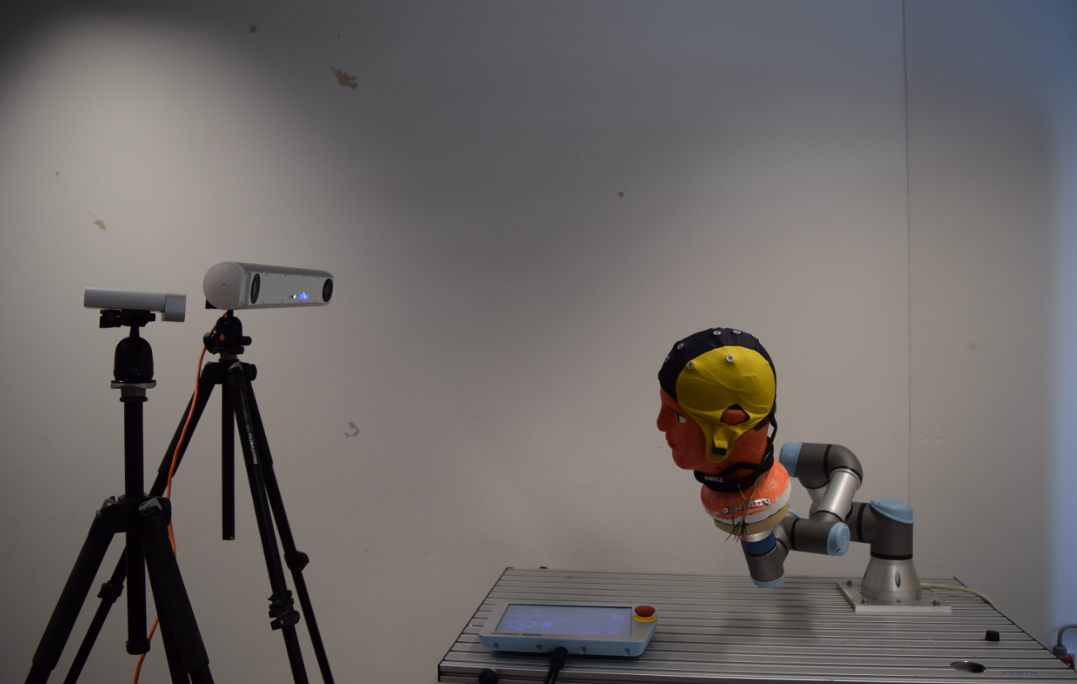

Slide 26
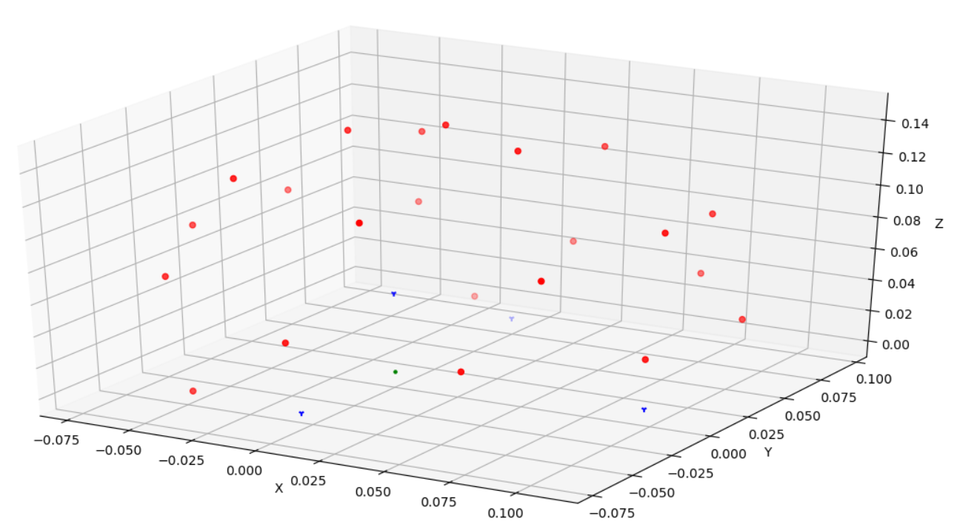
Z
Y
X

Slide 27
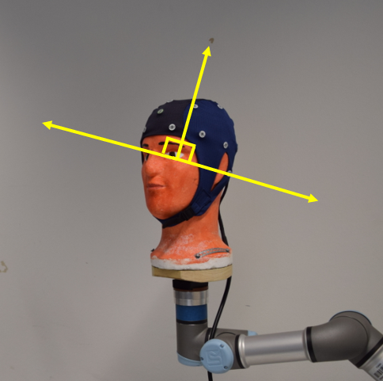
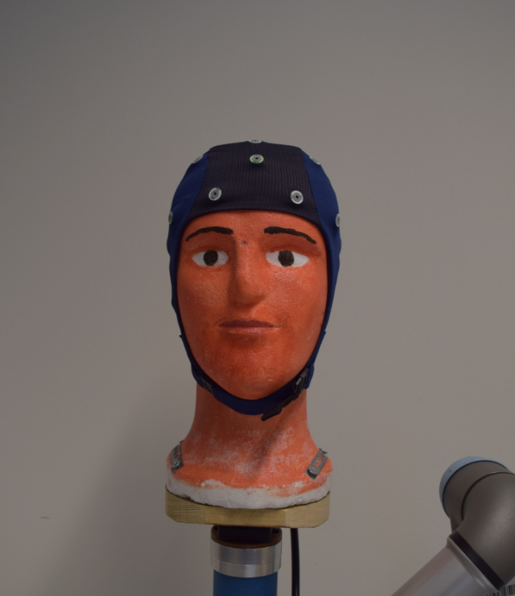
Z
Z
X
Y
Y

Slide 28
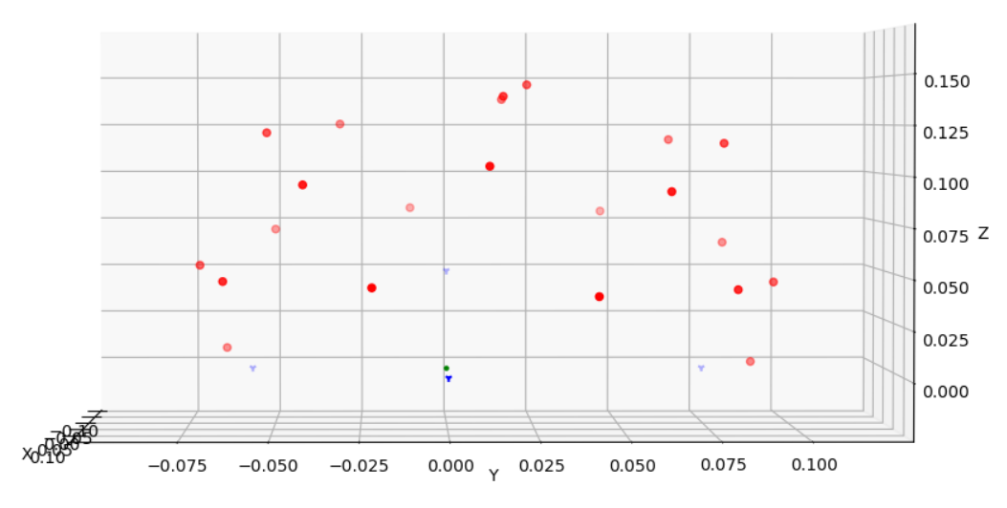
Z
Y

Slide 29
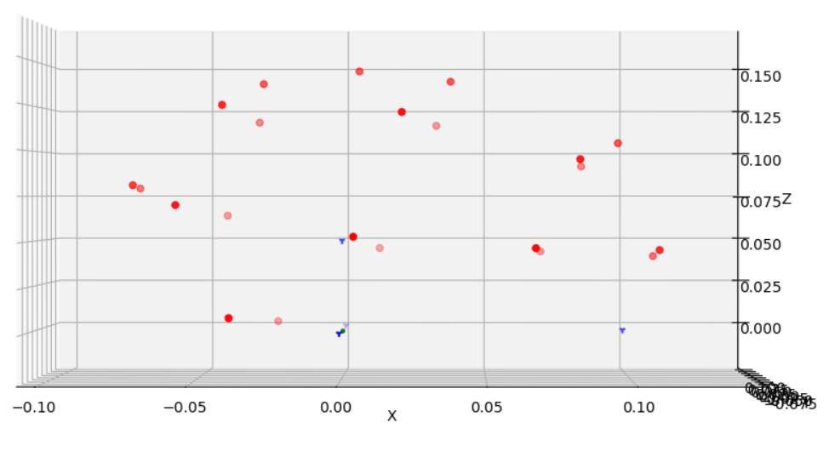
Z
X

Slide 30
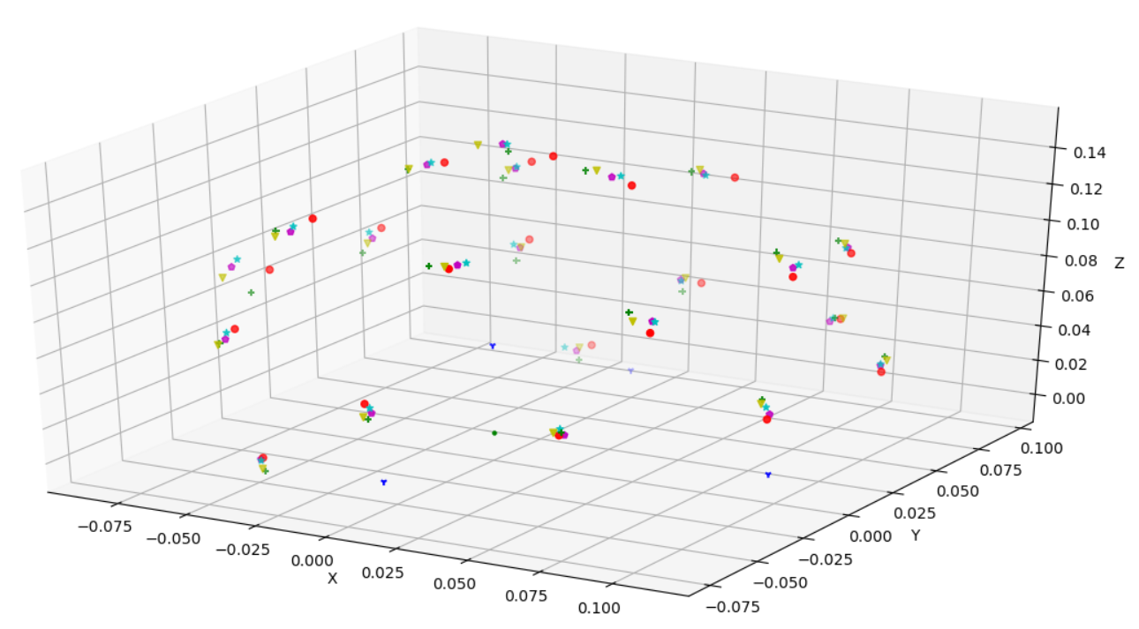
Z
Y
X

Slide 31
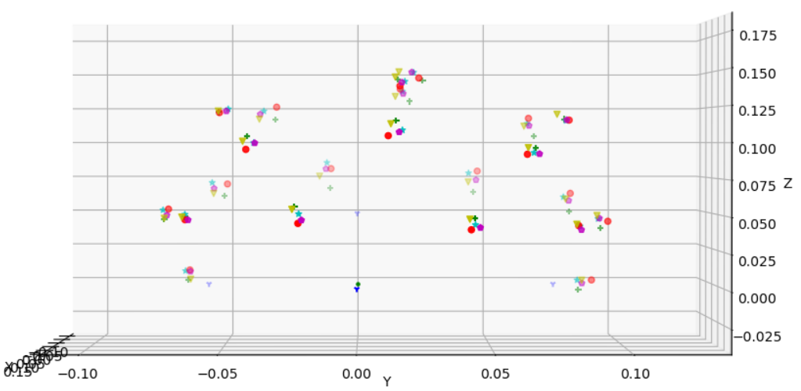
Z
Y

Slide 32
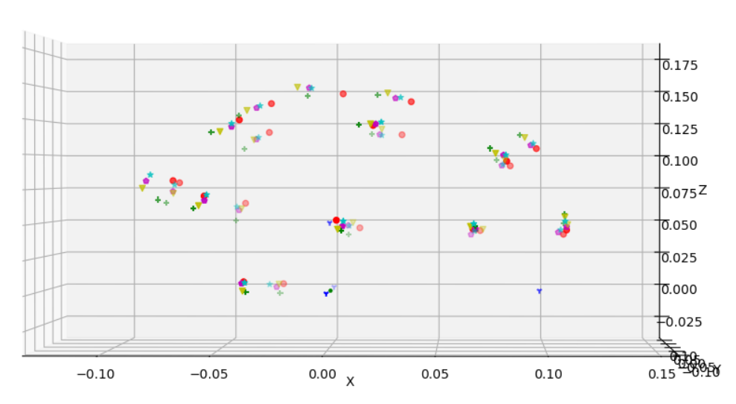
Z
X

